Slide 1
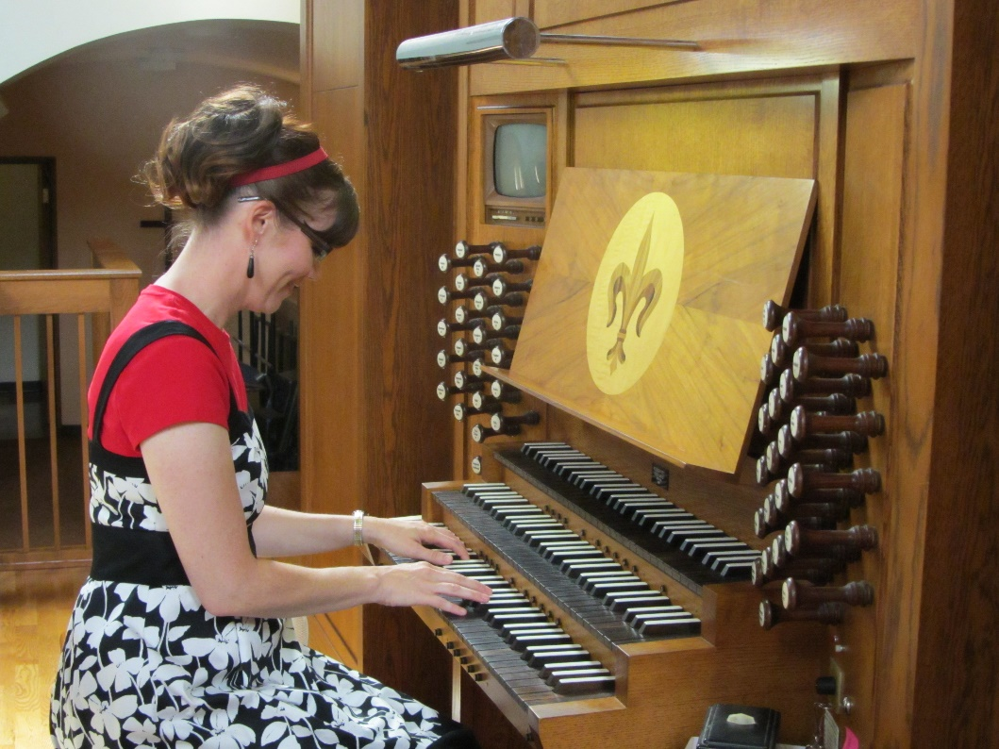
Tools for the LDS Organist
Transitioning
from Pianist
to Organist

Slide 2
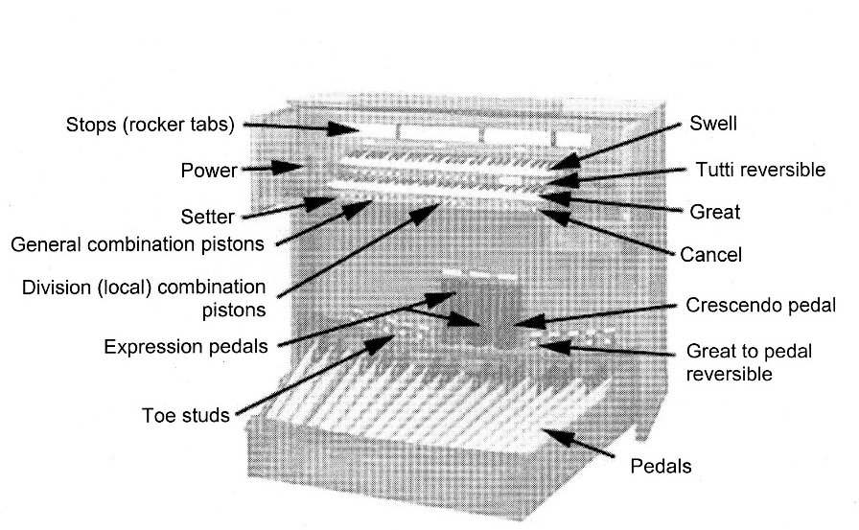
Know YOUR Organ

Slide 3

Listen Carefully
Sound vs. NO Sound
Legato when needed
Creating Beautiful Sounds
Do I LIKE the sounds I am making?

Slide 4
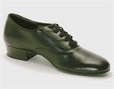

Organ Shoes

Slide 5
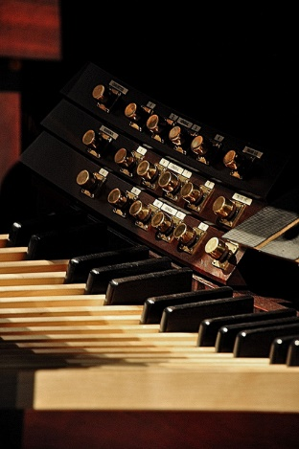
Pedals
Use heel and toe of both feet
Adjust Bench
Knees Together
Heels Together

Slide 6
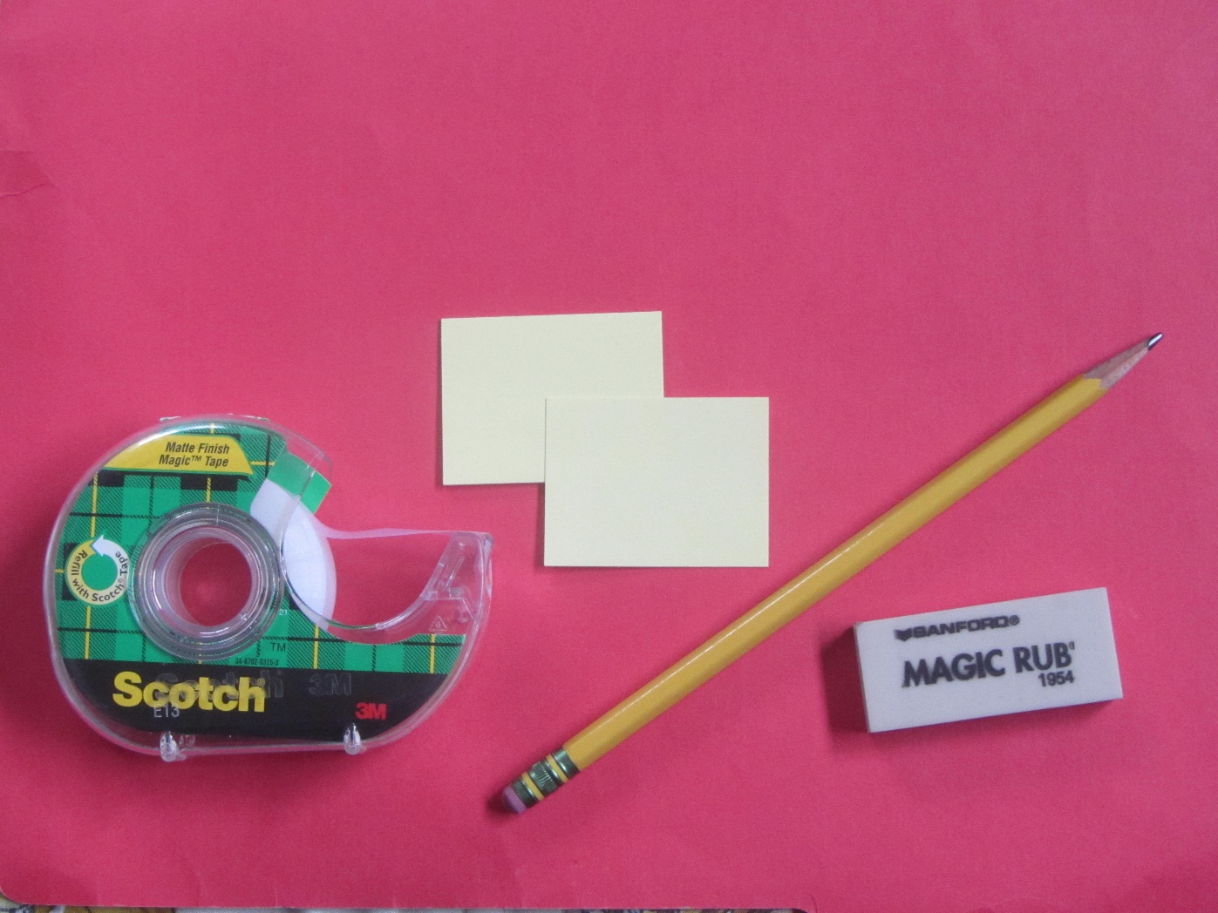
Tools of the Trade
Tools of the Trade

Slide 7

Fingering Options
Direct Fingering
Finger Crossing
Finger Substitution
Finger Glissando
Thumb Glissando
Redistribution of inner part

Slide 8

Hymnbook
Large size
Spiral Binding
Put your name on it

Slide 9
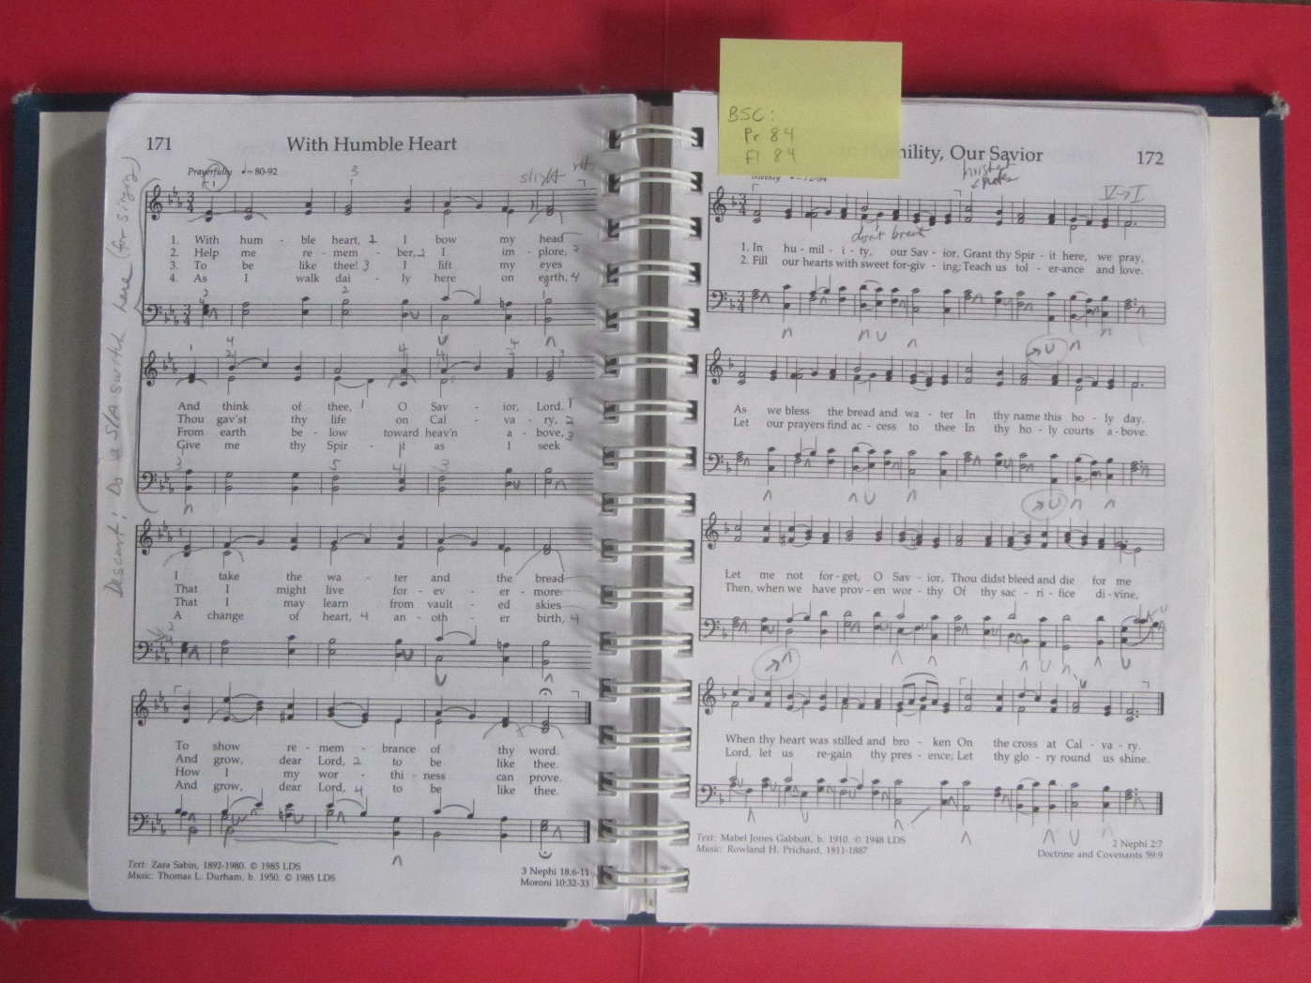
Open Hymnbook

Slide 10
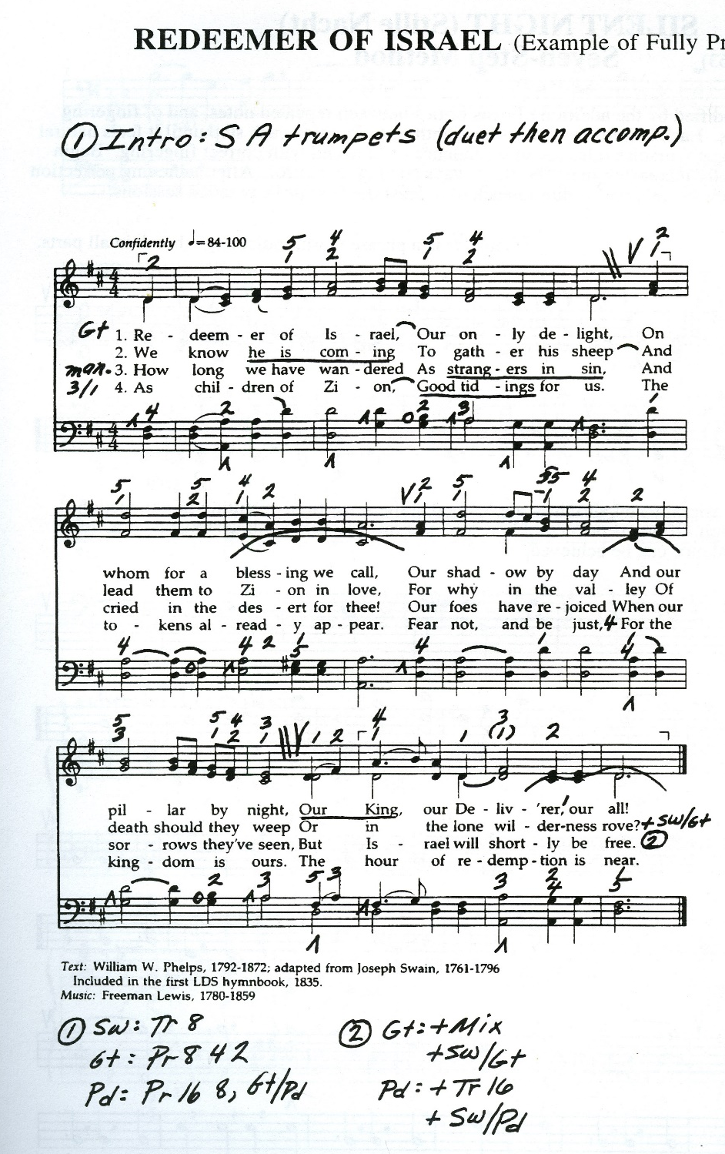
Prepare the Score
Text: Where to “breathe”
Indicate registration choices and changes
Mark critical fingering and pedaling

Slide 11
FREE Organ Training Materials
www.organ.byu.edu

Slide 12
The New LDS Organist
Focuses on effective Hymn playing
Includes 25 simplified hymns

Slide 13
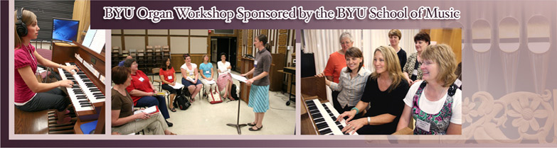
BYU Organ Workshop
August 6 – 9, 2013

Slide 14
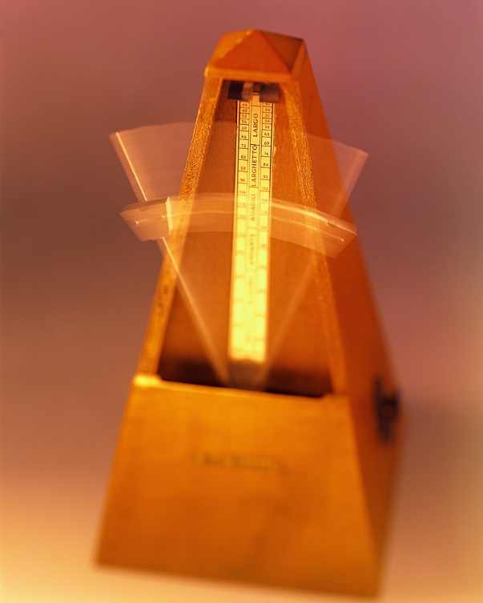
Practice, Practice, Practice!
Practice slowly and in time
Practice each voice independently, with the correct fingering/pedaling
Sing one part while playing a different part
Combine parts
Practice registration changes

Slide 15
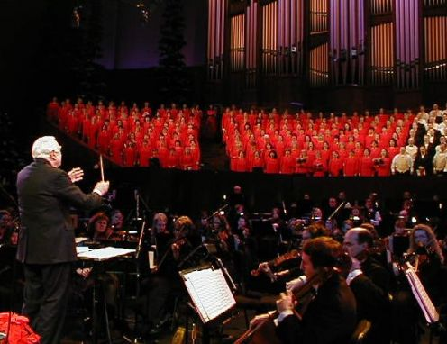
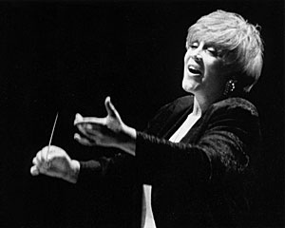
Practice with your Music Director

Slide 16
Practice Makes Perfect….
Only when practice IS perfect!

Slide 17
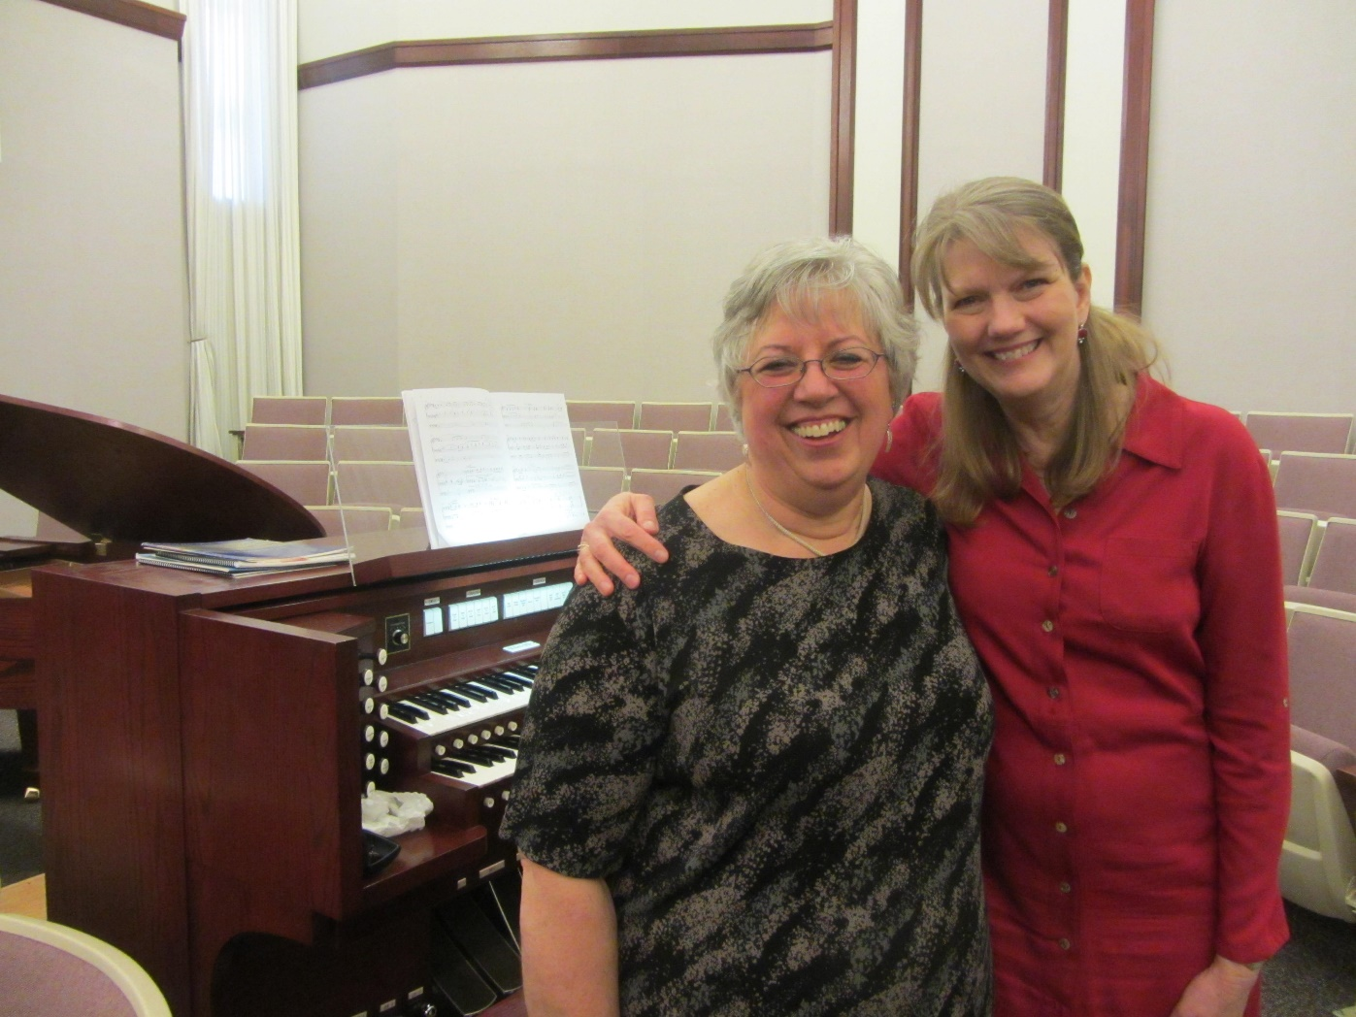
Feedback, especially questions about Loudness
Ask YOURSELF
Ask a FRIEND

Slide 18
Treasure this opportunity to learn a new skill, to learn a new way to serve the Lord!

